Slide 1
Physical Security

Slide 2
Let’s think like an attacker…

Slide 3
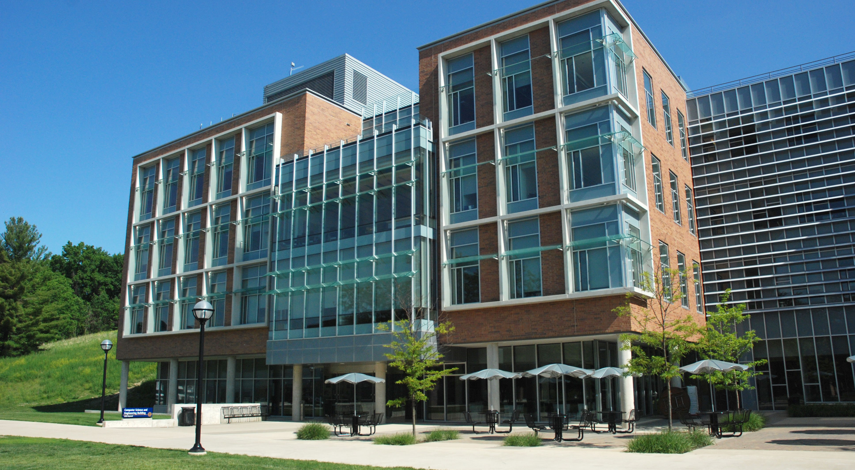

Slide 4
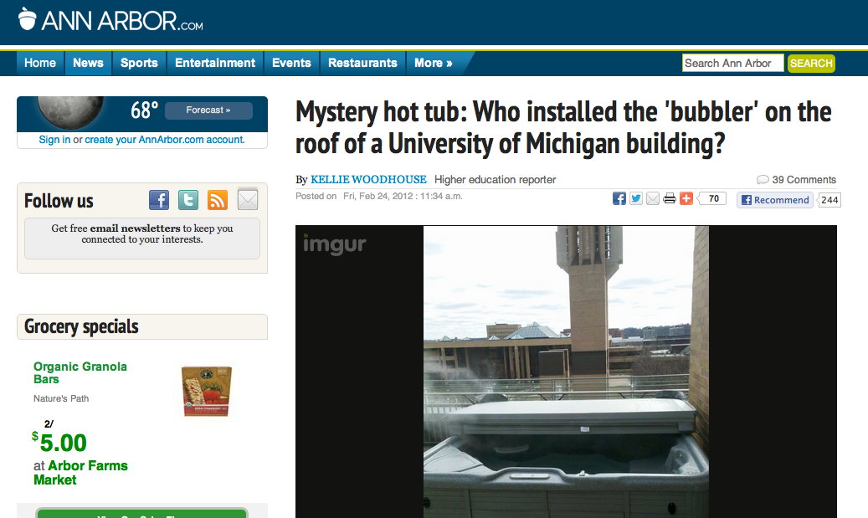

Slide 5
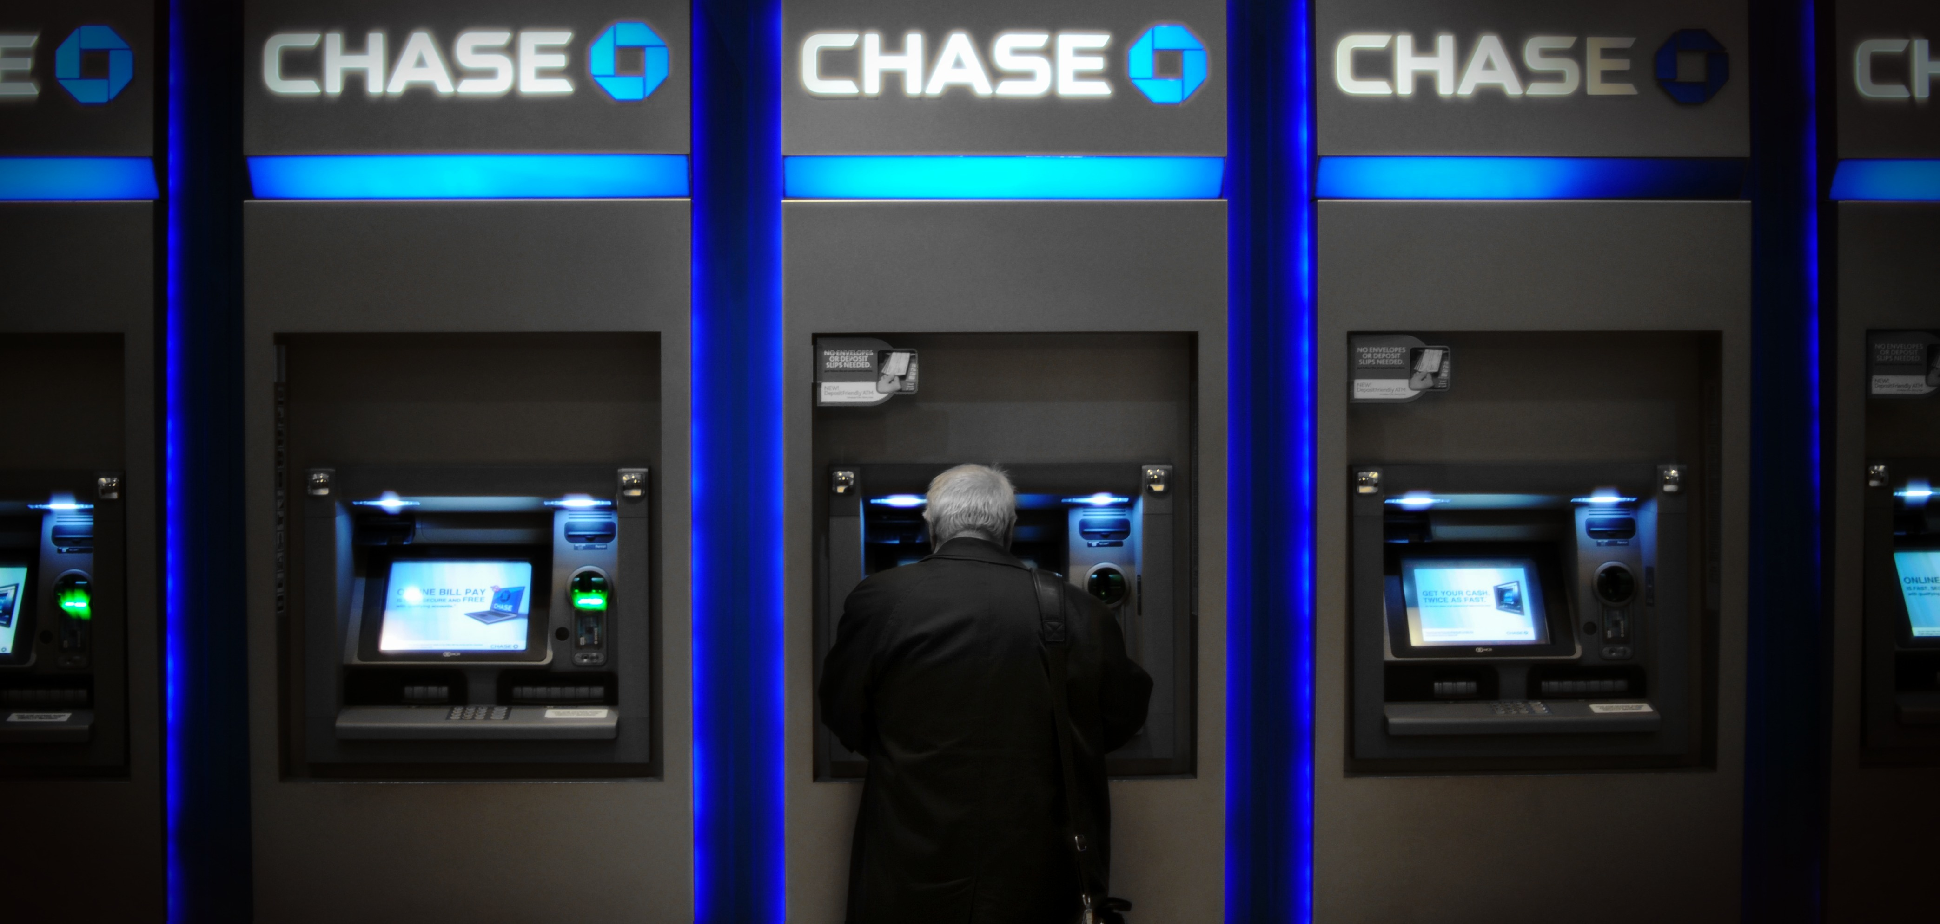

Slide 6
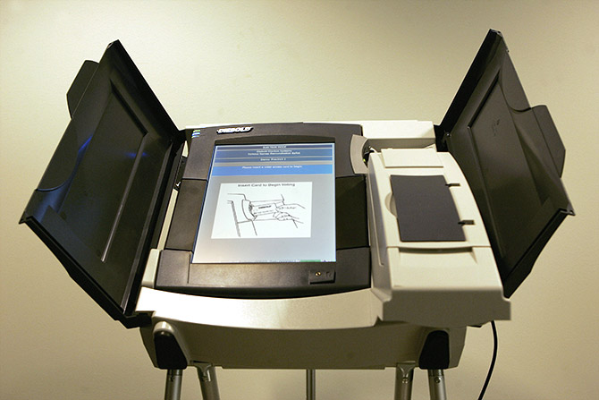
(voting machine)

Slide 7
What Is Physical Security?
Any physical object that creates a barrier to unauthorized access
This includes: locks, latches, safes, alarms, guards, guard dogs, doors, windows, walls, ceilings, floors, fences, door strikes, door frames and door closers

Slide 8
Destructive vs. Nondestructive Entry
Destructive entry
Involves using force to defeat physical security
Methods involve crowbars, bolt cutters and sledge hammers
Negative impact on IT resources is apparent
Remediation steps also obvious
Nondestructive entry
Compromises security without leaving signs of a breach
Defeats intrusion detection
Greater and long-term threat

Slide 9
Is Physical Security An IT Concern?
You have been working hard to secure your network from cyber attacks
Redundant layers of authentication, firewalls, and intrusion detection systems should protect against electronic methods of entry
But what if an attacker gains access to the server room or network wiring closet ...
Is you network still safe?

Slide 10
Type of Threats to Physical Environment
Natural / Environmental
Earthquakes, floods, storms, hurricanes, fires, snow/ice
Consequence of natural phenomena
Man made / Political Events
Explosives, disgruntled employees, unauthorized access, employee errors, espionage, arson/fires, sabotage, hazardous/toxic spills, chemical contamination, malicious code, vandalism and theft
Acts of commission or omission
© CISSP® Common Body of Knowledge Review

Slide 11
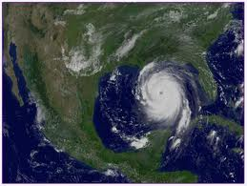
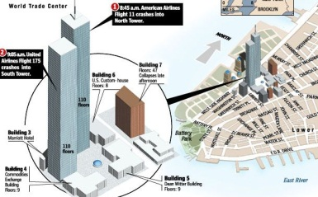
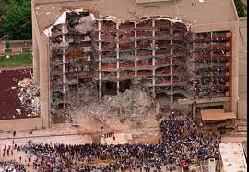
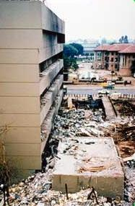
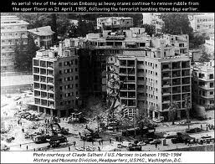
Lessons-Learned for U.S.
Major Domestic Events:
2005 Hurricane Katrina (1,836)
2001 9/11 Attack: World Trade Center, Pentagon, and Shanksville, PA (2,982)
1995 Federal Office Building, Oklahoma City (168)
Major International Events:
1998 U.S. Embassy, Kenya (237)
1983 Beirut Barracks, Lebanon (309)
© CISSP® Common Body of Knowledge Review

Slide 12
Categories of Security Controls
Management (Administrative) Controls
Policies, Standards, Processes, Procedures, & Guidelines
Administrative Entities: Executive-Level, Mid.-Level Management
Physical Controls
Physical Security (Facility or Infrastructure Protection)
Locks, Doors, Walls, Fence, Curtain, etc.
Service Providers: FSO, Security Guards, Dogs
Technical (Logical) Controls
Access Controls , Identification & Authorization, Confidentiality, Integrity, Availability, Non-Repudiation.
CCTV & Camera, IDS, Moisture detection system, Fire/Smoke detection system, Fire suppression, Environmental control system, UPS, etc.
Service Providers: Building Architect, Critical Infrastructure Protection (CIP) Engineer, Operations Center.
© CISSP® Common Body of Knowledge Review

Slide 13
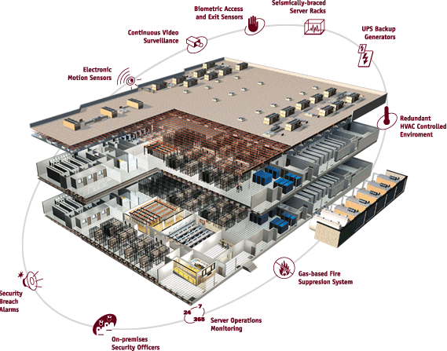
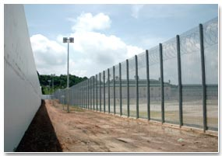
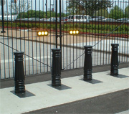
Security Countermeasures & Technologies Strategic Approach to Physical Security …(2/2)
Defense-in-depth
Source: Global Crossing website

Slide 14
Physical Controls – Facility Construction
Structured barriers: Perimeter structure
Walls & Fencing
Specific gauge and fabrication specifications (e.g. No. 11 gauge galvanized chain-link fencing material.)
Specify height, or need for “top guard” (e.g. 8-ft in height, 6-in. under ground with top guard.)
Height | Protection
1 meter / 3 – 4 ft | Deters casual trespassers
2 meter / 6 – 7 ft | Too high to climb easily
2.4 meter / 8 ft with top guard | Deters determined intruder
Source: Official (ISC)² Guide to The CISSP Exam

Slide 15
Physical Controls – Facility Construction
Structured barriers: Entry points
Gates, bollards, roadways.
Doors, windows, ventilation airways, manhole covers, etc.
Department of State and DoD Anti-Ram Vehicle Barrier Certification Criteria (SD-STD-02.01):
Vehicle Weight: 15,000 lb.
Speed Rating | Speed at Impact
K4 | 30 mph
K8 | 40 mph
K12 | 50 mph
Vehicle Weight: 15,000 lb.
Penetration Rating | Penetration Distance
L3 | < 3 ft
L2 | 3 – 20 ft
L1 | 20 – 50 ft
Reference: http://www.probarrier.com/faq/certify.asp

Slide 16
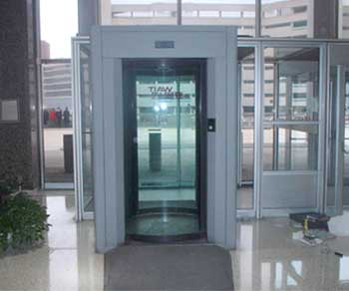
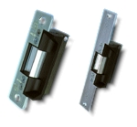
Technical Controls – Entrance Protection
Entry access control systems
Turnstiles
Revolving doors that can be activated to “lock” and not allow unauthorized individuals to enter or leave facility
To prevent “piggybacking”.
Mantraps
Routing people through two stationary doorways
Fail-safe
Door defaults to being unlocked.
Fail-secure
Door defaults to being locked.

Slide 17
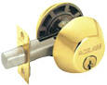
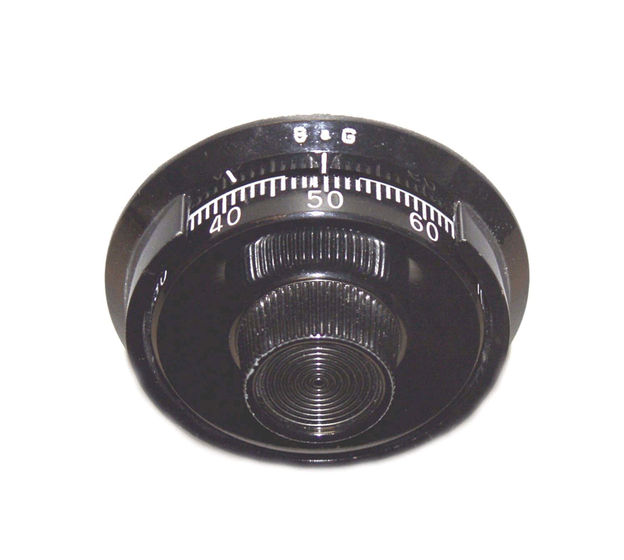
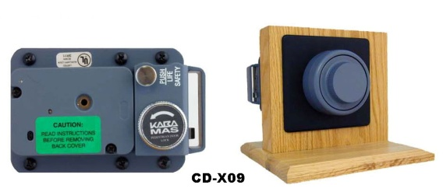

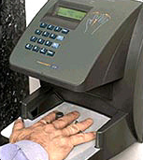
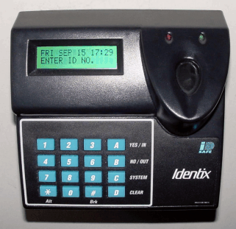
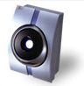
Technical Controls
Entry access control systems – Locks
Mechanical locks:
Key
Combination locks
Magnetic locks
Electronic locks:
Combination lock
Proximity / RFID badge
Bio-metric

Slide 18
How does one evade these controls?

Slide 19
Social Engineering

Slide 20
Scenario
You have conducted pen tests of your web site
You have a sophisticated ASA firewall sitting on the border which can use adaptive rule sets to detect potential attacks
You have security officers monitoring the inbound packet streams using SNORT to look for attacks
Your website is bulletproof…

Slide 21
Scenario
But…and this really happened
At 3 am a guy walks up to the front lobby door and holds up a sign to the cleaning crew that says in English and Spanish “Perdi, mis llaves!”
The guy has an ID card that says “Marriott Elite Silver”. The crew lets him into the building.
Guy walks around and finds a locked door marked “Server Room”. Unfortunately, it’s a crypto lock.

Slide 22
Scenario
Three guesses and no luck.
Guess what, the Armstrong ceiling tiles!
Turn over a trashcan, pop the tile, the wall the doesn’t go all the way up.
The guy climbs over the wall and is in the server room safe and sound.
Now, the guy walks over to your web server, pops Knoppix into the DVD drive and reboots the server.

Slide 23
Scenario
With knoppix running, mount the hard drive, locate the windows passwords take a quick picture, reboot the server, remove the disk, exit the building.
The adminstrator password is “ScoobyDoo!”
Later that night, attempt to connect to the linux server which is available via ssh, login as root with password, well, you guessed it.
Dump all employee data with SS numbers, etc. from the database.

Slide 24
The Social Engineering Threat
Spear Phishing, et. al
This is the art of getting you to compromise your own systems
“Click this link to reset your bank password”
True Social Engineering
If I can talk my way past your guards, your security system, your fence, your locks, your guns and tasers, etc. You have already lost.
Beware the human with the clipboard and laminated id card.

Slide 25
Avoiding Social Engineering
Training, Training, Training
Your individuals with access must be trained properly!
EVERYONE must have their ID checked and be escorted
Your staff must also be trained properly.
Anyone without ID should be approached, politely.
“Hi, may I help you find somone?”
You must eliminate phishing attacks via regular and repeated training. You must test this on a regular basis.

Slide 26
Locks and Keys

Slide 27
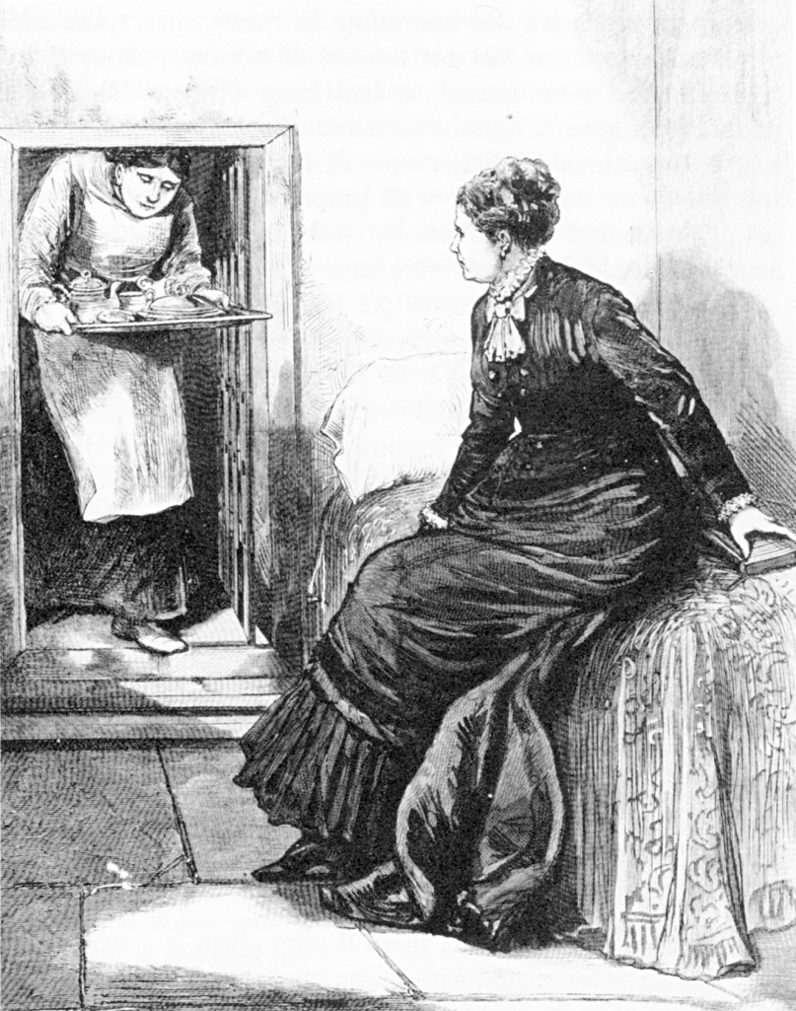
Legal Notice
Laws regarding lock picking vary significantly state-by-state
In most states purchase and possession of dedicated lock picking tools is legal
Penalties are raised significantly if you get caught using them in the commission of a crime
Public domain image from http://commons.wikimedia.org/wiki/File:Madame_Restell_in_jail.jpg

Slide 28
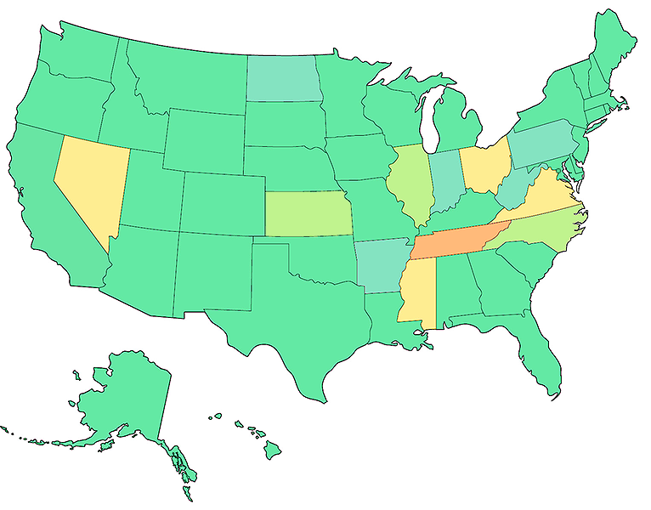
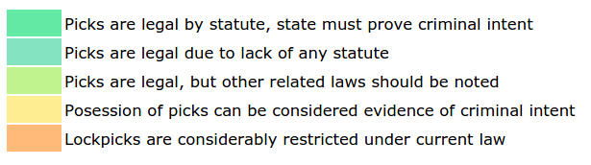
http://toool.us/laws.html

Slide 29
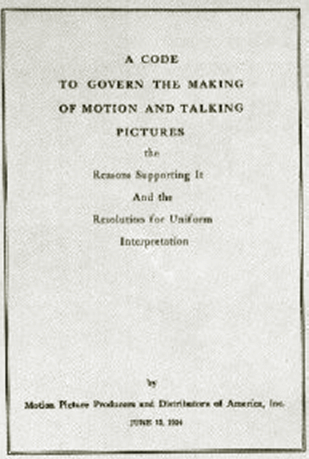
Lock Picking in Movies
Genuine lock picking in movies used to be prohibited
Before 1967, the Hays code (Motion Picture Production Code) required censorship of Hollywood movies
“All detailed (that is, imitable) depiction of crime must be removed, such as lock picking or mixing of chemicals to make explosives”
Public domain image from http://commons.wikimedia.org/wiki/File:Motion_Picture_Production_Code.gif

Slide 30
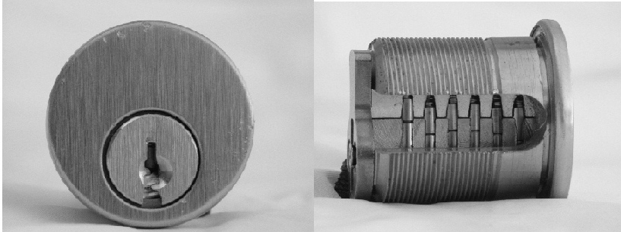
Pin Tumbler Lock

Slide 31
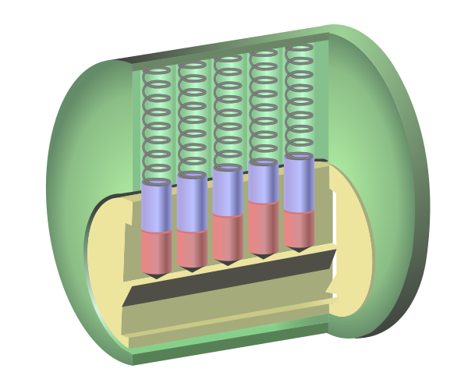

Slide 32
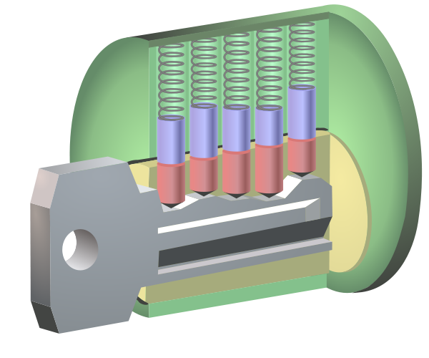

Slide 33
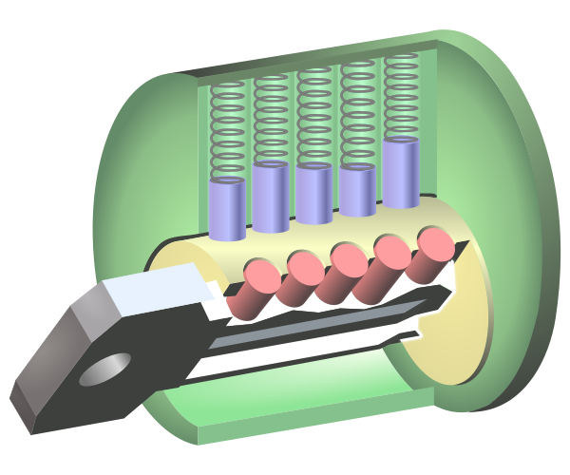
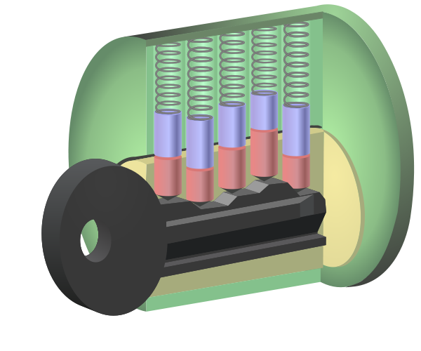

Slide 35
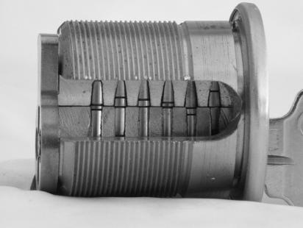
Notes:
Master Keyed Systems

Slide 36
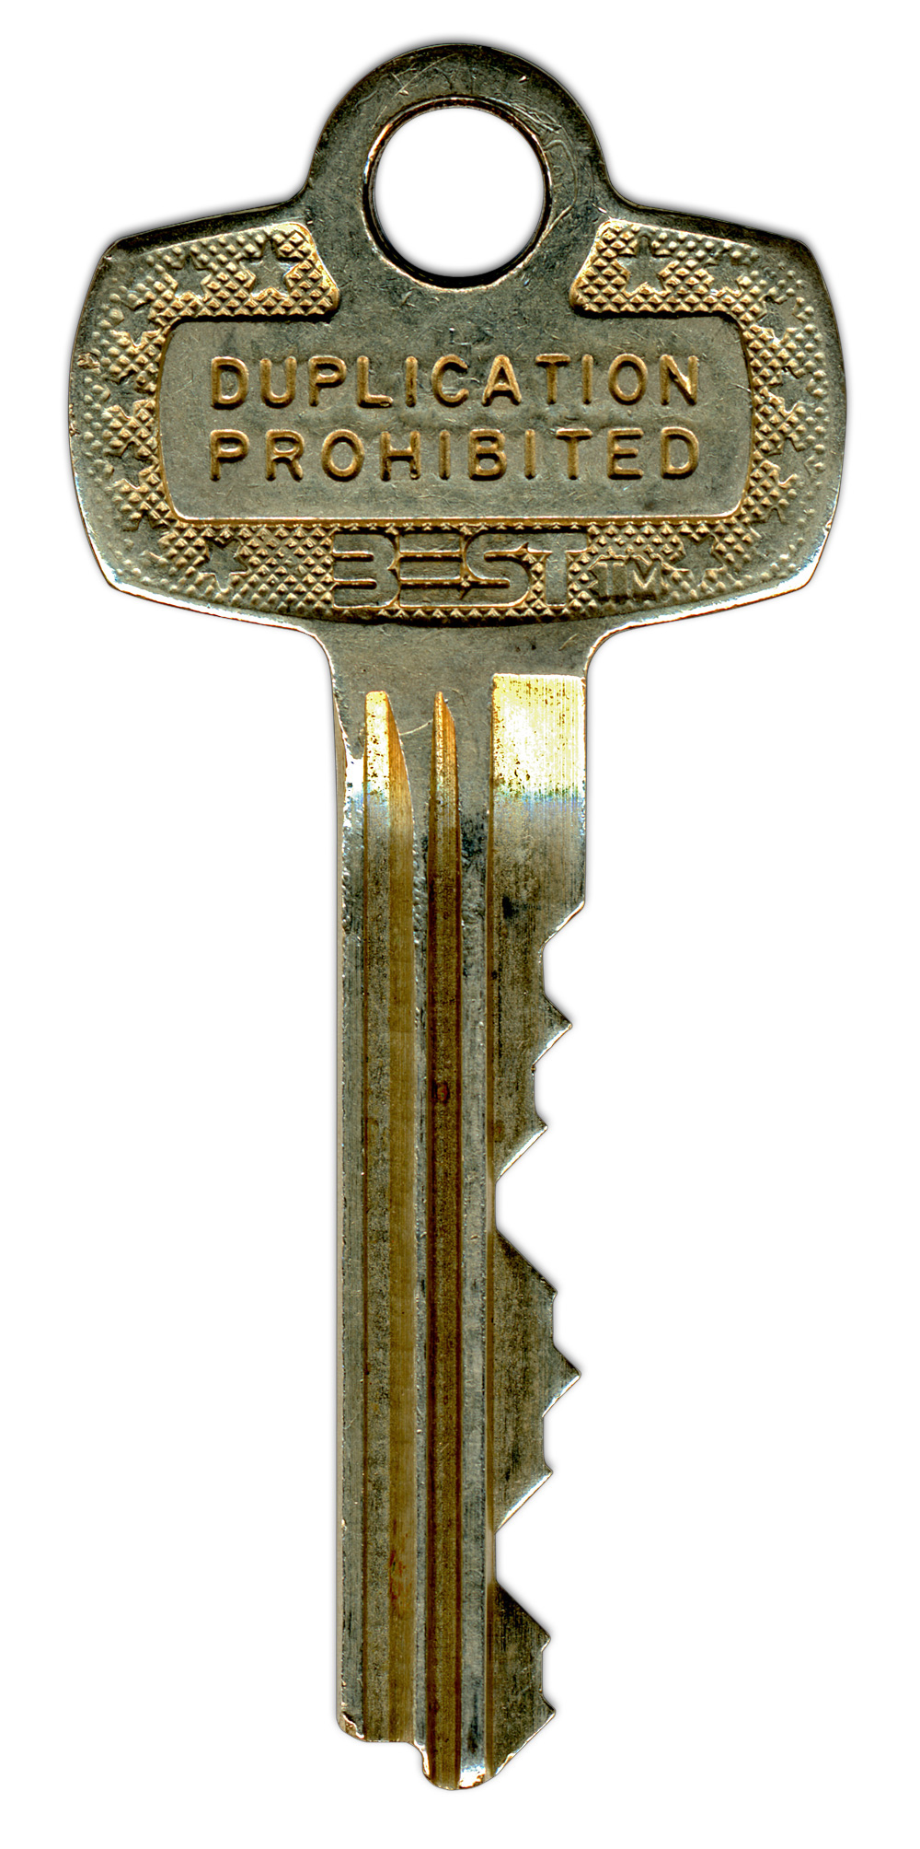
s
8⁷ = 2,097,152

Slide 37
Compromising Locks
For centuries, the lock has been one of the cornerstones of physical security
We rely on dozens of them every day to protect people and assets
The trust most people place in locks is unwarranted
Most locks can be easily compromised with nondestructive methods
Sometimes within seconds and with readily available tools
“Locks keep honest people honest”

Slide 38
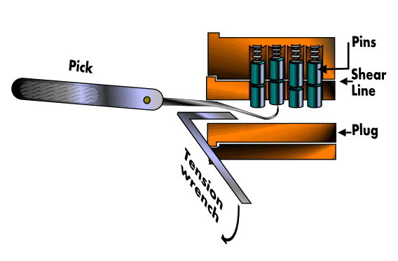
Feeler Picking
Apply light tension
Lift one pin at a time
Identify binding pin
Lift binding pin until it reaches the shear line
Setting the binding pin will rotate the lock slightly
Find next pin and repeat the process
Image from http://commons.wikimedia.org/wiki/File:Pin_and_tumbler_lock_picking.PNG used with permission under Gnu Free Documentation License 1.2

Slide 39
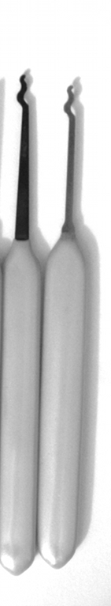
Scrubbing / Raking
Apply light tension
Work over pins back to front in a circular motion
attempting to pop them into the shear line with the combination of tension
Good for beginners
Usually employ snake pick or half diamond
Photo by Jennie Rogers included with permission.

Slide 40
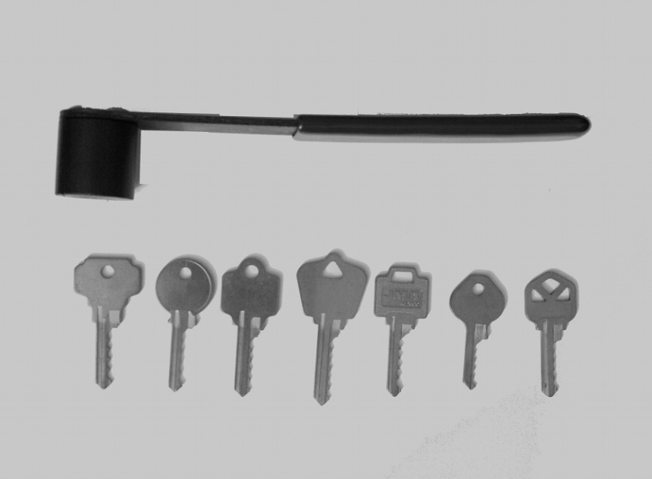
Bump Keys
Driver pins “jump” higher than the cylinder just for an instant
If a light rotational force is applied, the cylinder will turn
Lock bumping is a very fast method for opening the lock
The lock is not damaged
Defense: different weighted pins
Photo by Jennie Rogers included with permission.

Slide 41
How many of you have your keys sitting out?

Slide 42
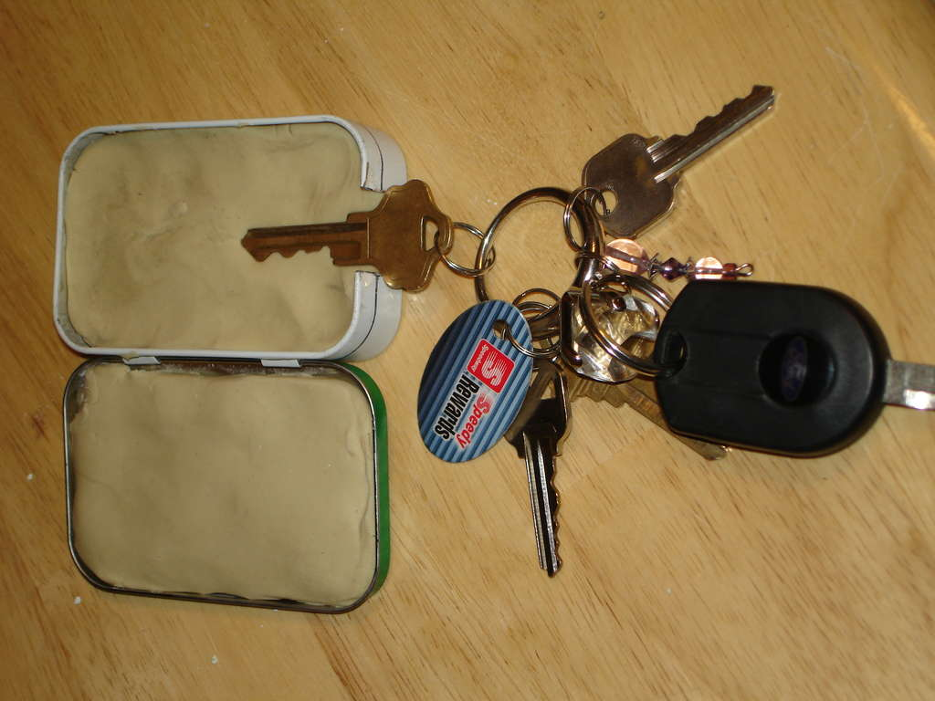

Slide 43


Slide 44
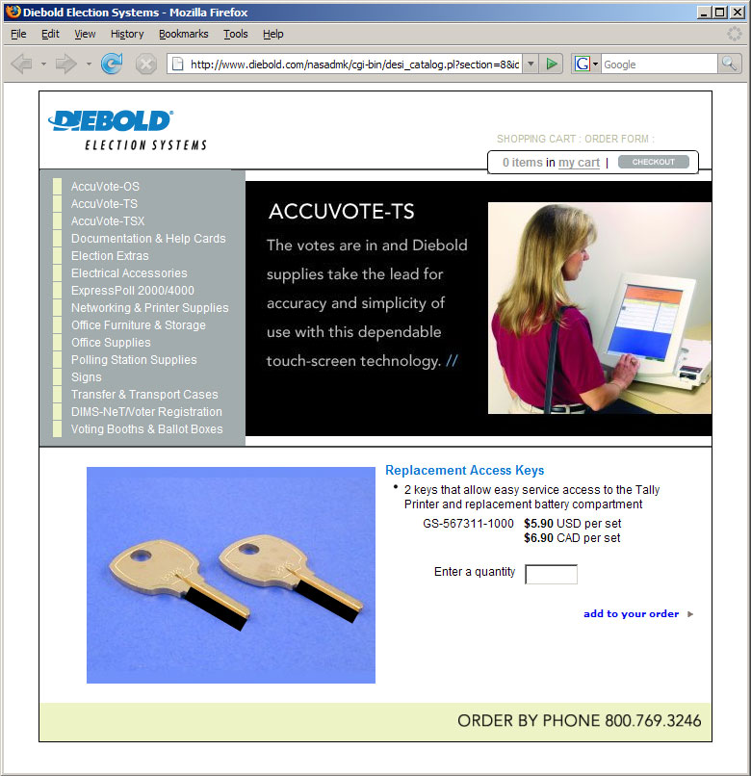

Slide 45
Why is physical security an IT concern?

Slide 46
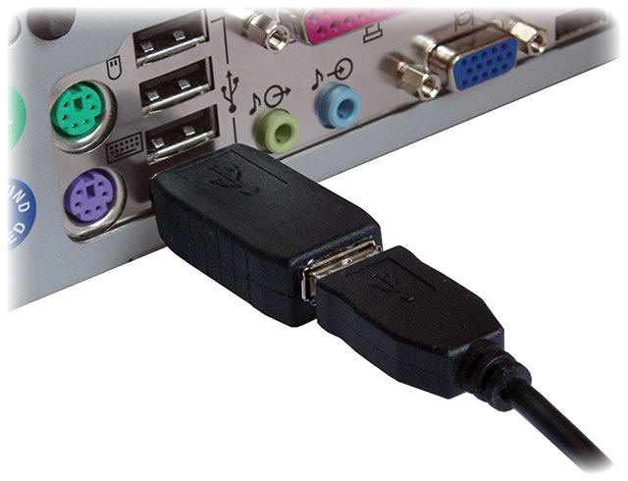
physical access == total access?

Slide 47
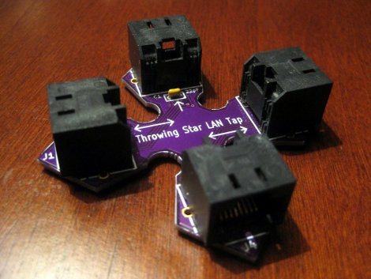

Slide 48
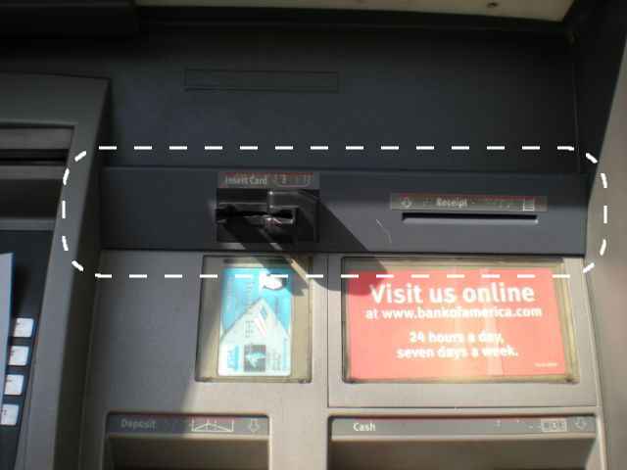

Slide 49
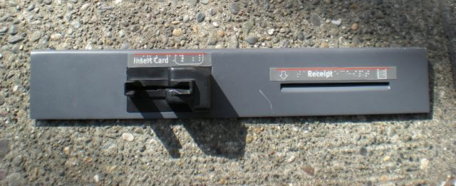

Slide 50
What about Encryption?

Slide 51
Hibernation
Modern machines have the ability to go into a powered-off state known as hibernation.
While going into hibernation, the OS stores the contents of machine’s memory into a hibernation file (such as hiberfil.sys) on disk so the computer can be quickly restored later.
But… without additional security precautions, hibernation exposes a machine to potentially invasive forensic investigation.
1. User closes a laptop computer,
putting it into hibernation.
2. Attacker copies the hiberfil.sys
file to discover any unencrypted
passwords that were stored
in memory when the computer
was put into hibernation.

Slide 52
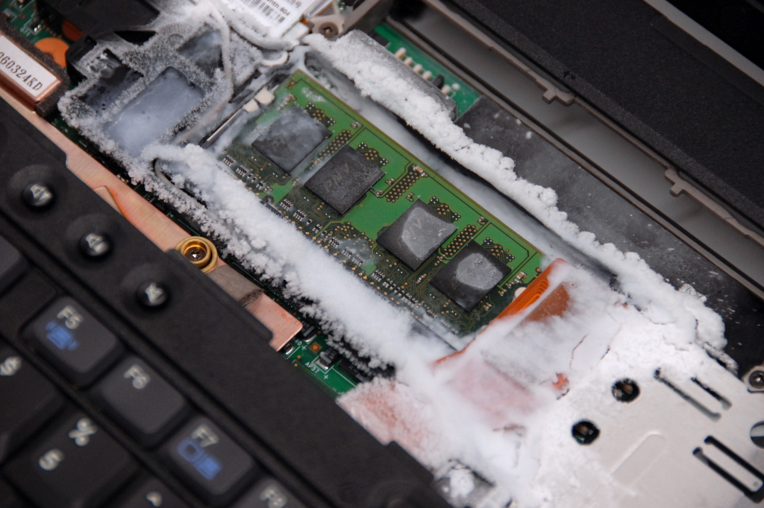

Slide 53
Proximity

Slide 54
Signal Emissions
Computer screens emit radio frequencies that can be used to detect what is being displayed.
Visible light reflections can also be used to reconstruct a display from its reflection on a wall, coffee mug, or eyeglasses.
Both of these require the attacker to have a receiver close enough to detect the signal.

Slide 55
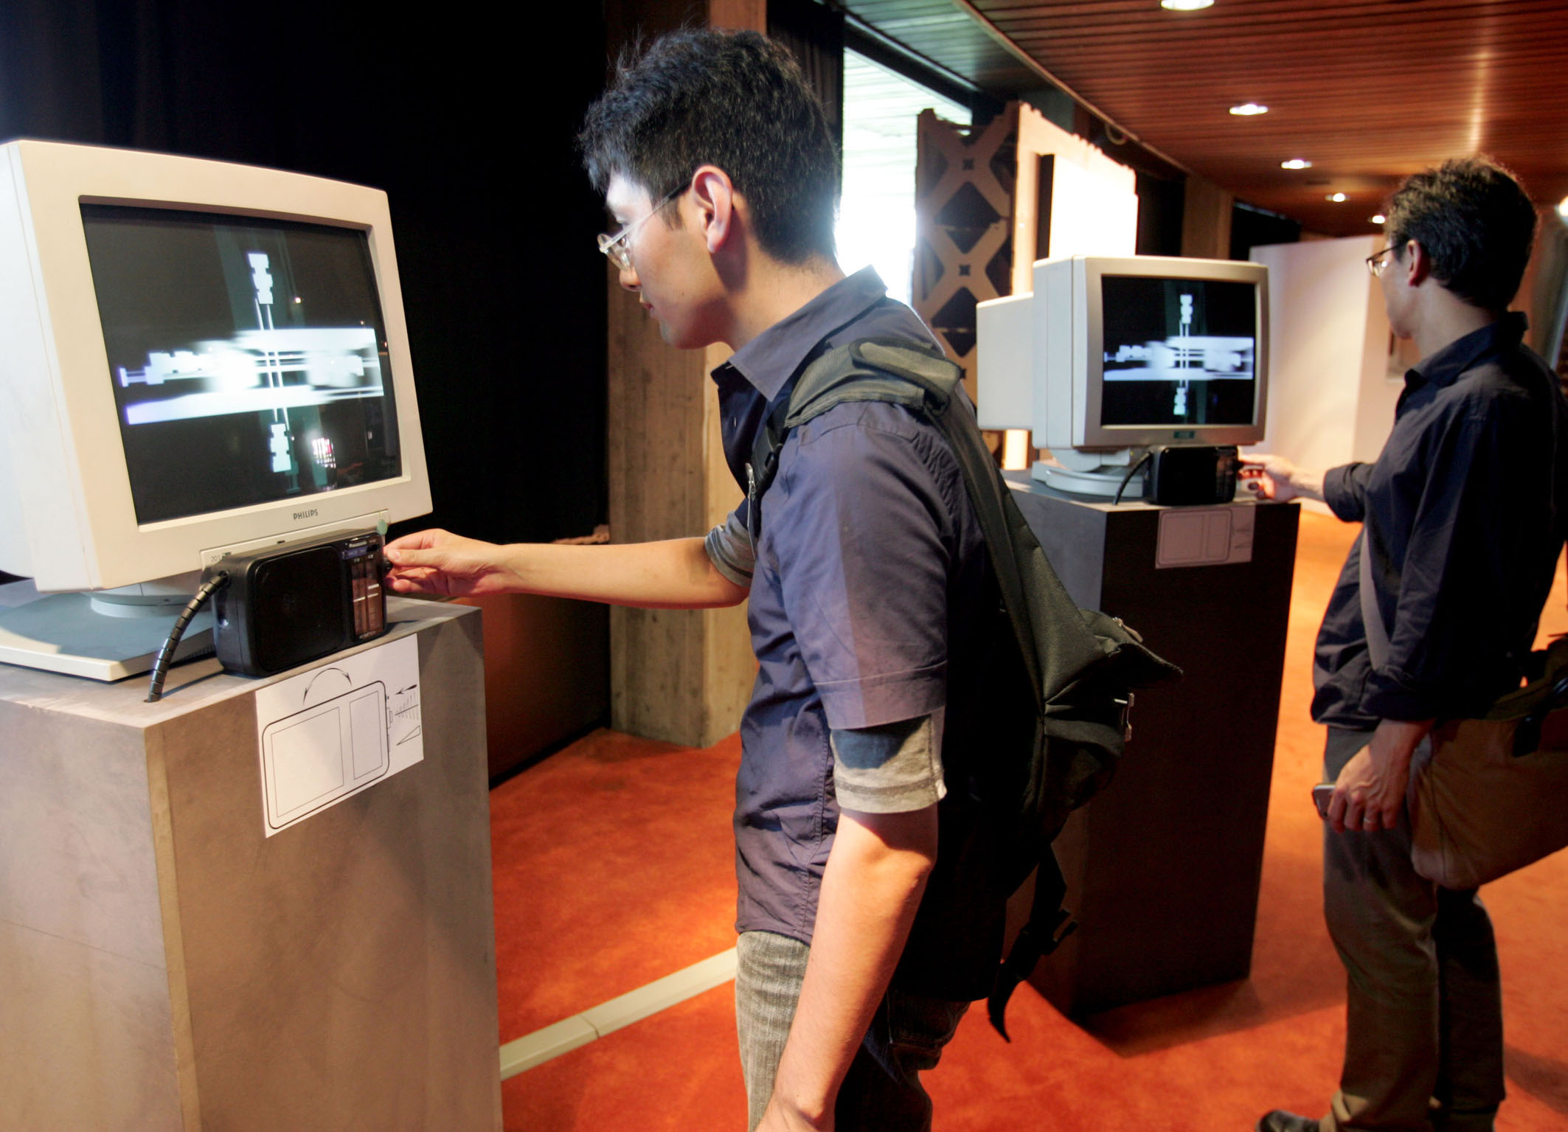

Slide 56
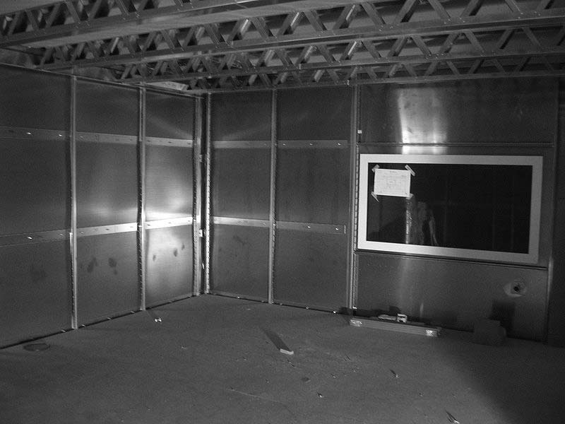
Faraday Cages
To block electromagnetic emanations in the air, we can surround sensitive equipment with metallic conductive shielding or a mesh of such material, where the holes in the mesh are smaller than the wavelengths of the electromagnetic radiation we wish to block.
Such an enclosure is known as a Faraday cage.

Slide 57
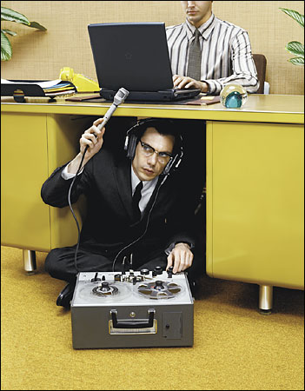
Acoustic Emissions
Dmitri Asonov and Rakesh Agrawal published a paper in 2004 detailing how an attacker could use an audio recording of a user typing on a keyboard to reconstruct what was typed.

Slide 58
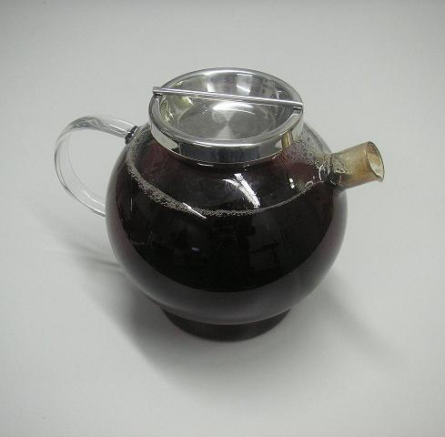

Slide 59
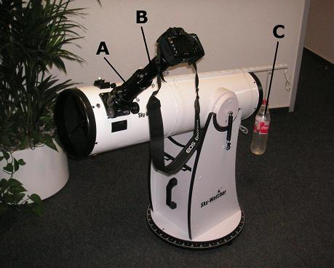

Slide 60
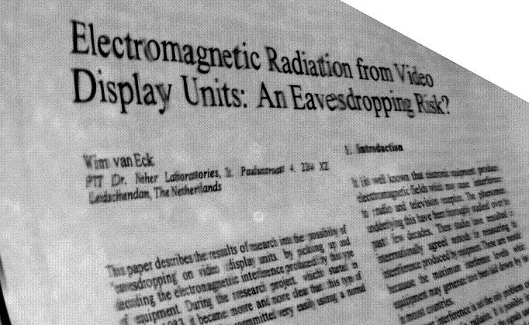

Slide 61
